Slide 1


FINAL PRESENTATION
Group 25 - SkySytem
18 December 2025

Slide 2

Presented by → Beatriz Marques
SUMMARY
1
TEAM
5
METRICS
2
VISION AND SCOPE
6
KPI
3
RELEASE PLAN
7
LESSONS LEARNED
4
BACKLOG ITEMS

Slide 3
1. TEAM

Slide 4
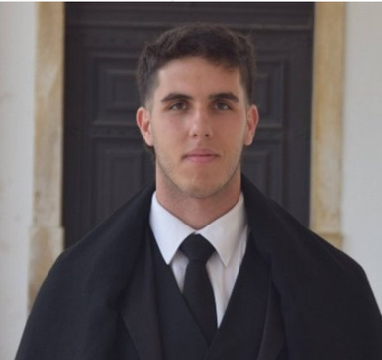
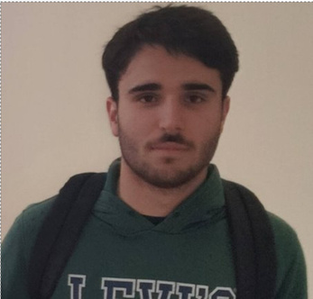
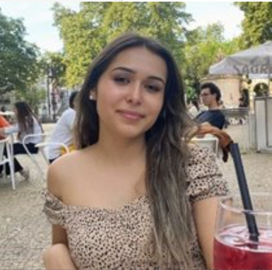
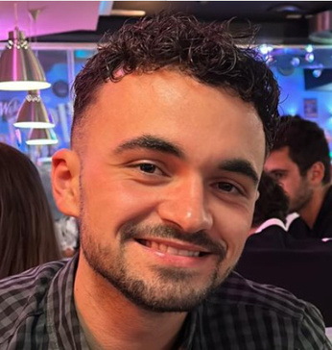
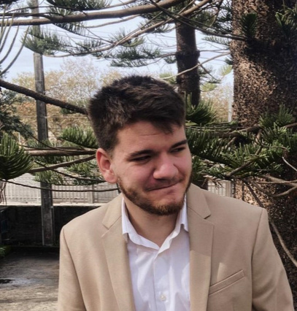
Presented by → Beatriz Marques
TEAM MEMBERS
Group 25
Link: repositorio_gitlab
Pedro Amorim
Tiago Oliveira
Beatriz Marques
António Correia
José Moreira
2022157609@isec.pt
2023129464@isec.pt
2022137934@isec.pt
2022141330@isec.pt
2022132718@isec.pt
2022157609
2023129464
2022137934
2022141330
2022132718
@mAd-5864
@thyi8
@beatrizsmrqs
@AntonioCorreia17
@jjMoreira

Slide 5
Presented by → Beatriz Marques
TEAM ROLES
Group 25
Link: repositorio_gitlab
Pedro Amorim
Tiago Oliveira
Beatriz Marques
António Correia
José Moreira
S0 →
Scrum Master
Dev
Product Owner
Dev
QA Engineer
S1 →
Dev
Scrum Master
QA Engineer
Product Owner
Dev
S2 →
QA Engineer
Dev
Scrum Master
Dev
Product Owner
S3 →
Dev
Product Owner
Dev
QA Engineer
Scrum Master
S4 →
Product Owner
QA Engineer
Dev
Scrum Master
Dev

Slide 6
2. VISION AND SCOPE

Slide 7



Presented by → António Correia
VISION AND SCOPE
THE PROBLEM : Generic & Transactional
THE VISION: Your
Intelligent Travel Companion
THE SCOPE: Flight &
Discovery
No Inspiration → Focuses only on logistics (dates/prices), ignoring discovery.
One-Size-Fits-All → Ignores user history and preferences.
Tedious → Planning feels like a chore, not an experience.
Personalized → Understands your unique "Travel Personality".
Proactive → Suggests destinations before you even search.
Inspiring → Transforms booking into an engaging journey.
Focus → Flight Reservations & Destination Discovery only.
Core Tech → AI "Inspire Me" Engine & Smart Flight Search.
Exclusions → No hotels or ground transportation for now.

Slide 8
3. RELEASE PLAN

Slide 9
Presented by → Tiago Oliveira
RELEASE PLAN
Release 1 MVP
Product Goal → Manage user preferences, suggest destinations based on user preferences, ability to search and filter flights​
Date → 20/Nov
Release → v1.0
Plan
US2, US4, US6, US7, US8​
Story Points → 1 XL + 1 L + 1 M + 2 S​
Release 2 Final
Product Goal →
Introduce the capability for users to save desired flights Favorites from the search results
Integrate a basic mechanism to provide
notifications related to these saved flights
Deliver the new UI enhancements
Integrate User Account
Date → 18/Dec
Release → v2.0
Plan
US1+US3+US9
Story Points → 1 L + 2 M

Slide 10
4. BACKLOG ITEMS

Slide 11

Presented by → José Moreira
BACKLOG ITEMS
Sprint 1
US4: New User Onboarding Quiz (M)
US2: User Travel Preferences (S)
US6: “Inspire Me” Destination Suggestions (XL)*
US7: Basic Flight Search (L)*
Sprint 3
US1: New User Registration and Login (L)
US3: User Trip Dashboard
Sprint 2
US6: “Inspire Me” Destination Suggestions (XL)
US7: Basic Flight Search (L)
US8: Filter and Sort Flight Results (S)
Sprint 4
US9 Flight Status Notification (M)

Slide 12
5. METRICS

Slide 13

Presented by → José Moreira
METRICS
PLANNED
DONE
User Stories : 9
Time effort
Product Owner: 16h
Scrum Master: 12h
QA Engineer: 14h
Team: 120
User Stories : 8
Time effort
Product Owner: 13h
Scrum Master: 13h
QA Engineer: 18h
Team: 160

Slide 14
Presented by → José Moreira
METRICS
PRODUCTION COST
Sprint 0: 46h → 9 200€
Sprint 1: 38h → 7 600€
Sprint 2: 40h → 8 000€
Sprint 3: 40h → 8 000€
Sprint 4: 40h → 8 000€
TOTAL COST → 40 800€

Slide 15
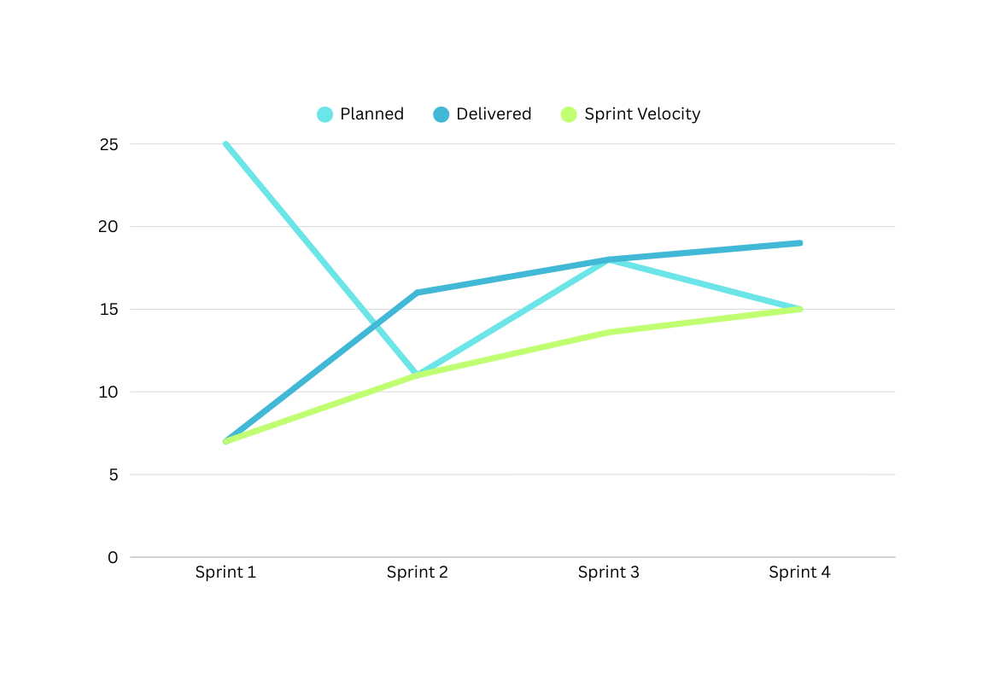
Presented by → Pedro Amorim
METRICS
PRODUCTIVITY
We applied the Fibonaci sequence to the T-Shirt sizes to convert them to Story Points.
(Task = 1 SP | S = 2 SP | M = 3 SP | L = 5 SP | XL = 13 SP )
Planned SP: 69
Delivered SP: 60
Average Sprint Velocity: 12

Slide 16
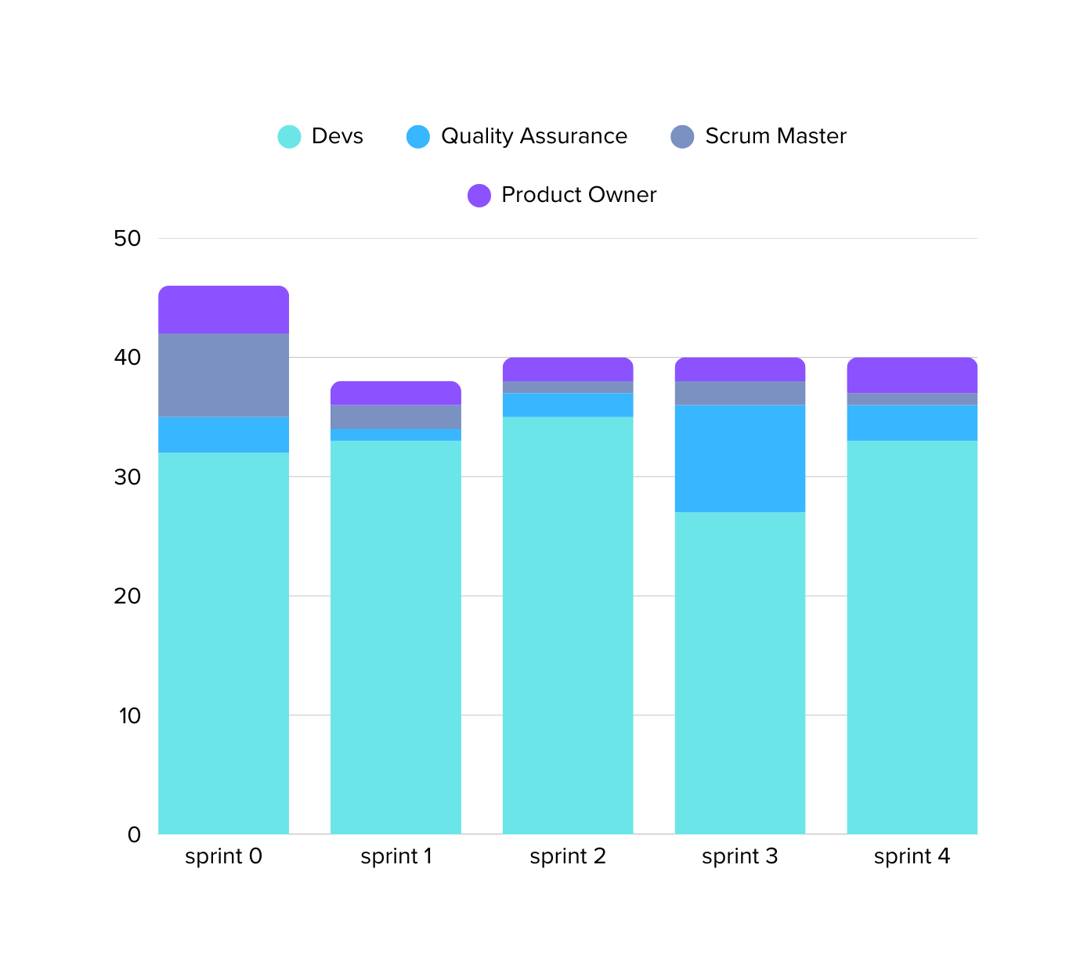
Presented by → Pedro Amorim
METRICS
EFFORT

Slide 17
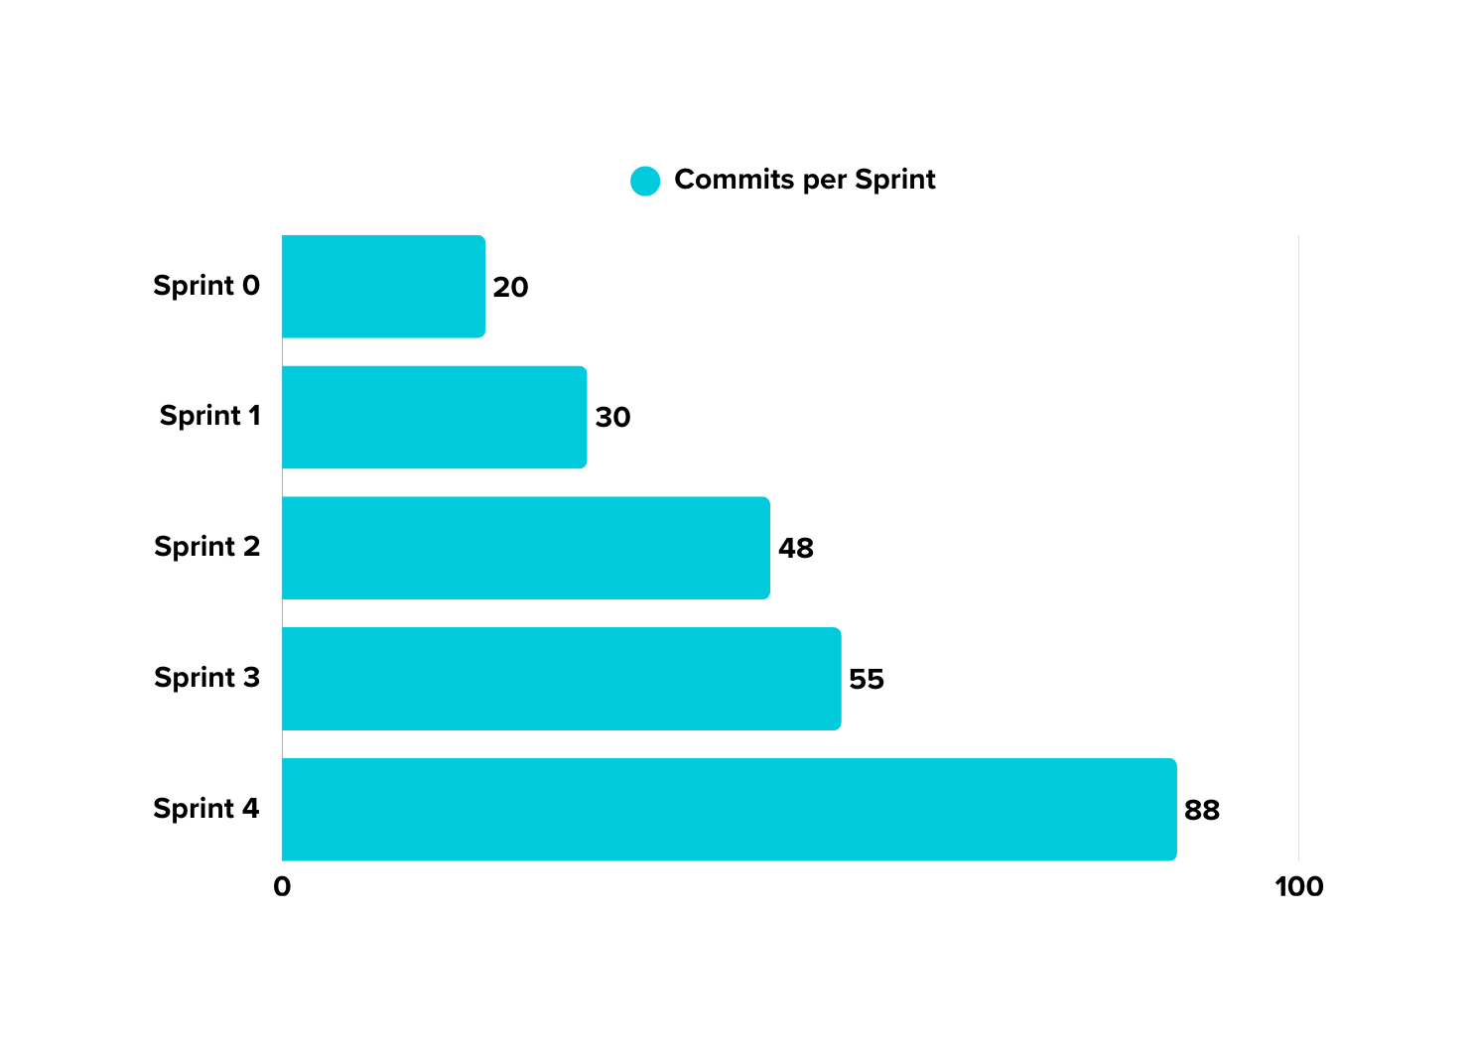
Presented by → Pedro Amorim
METRICS
EFFORT

Slide 18
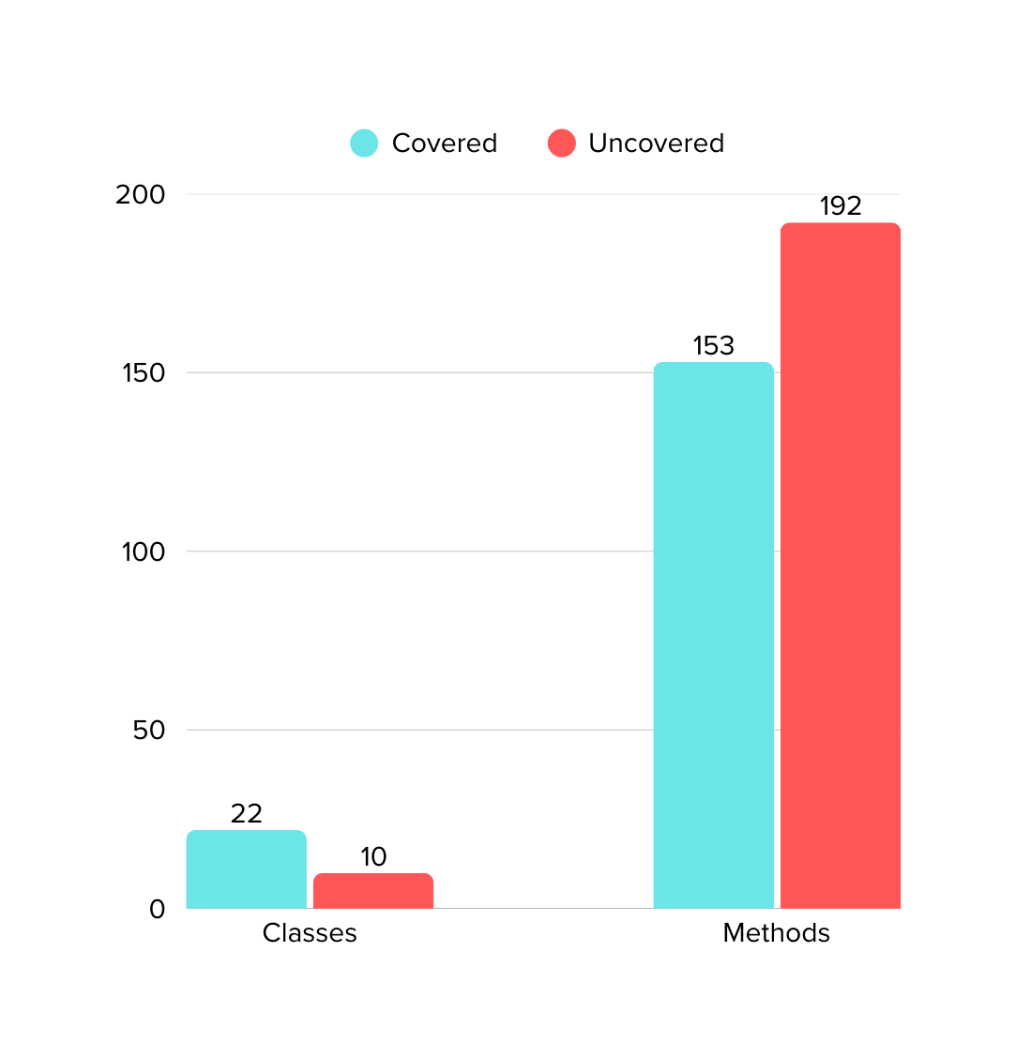
Presented by → António Correia
METRICS
QUALITY

Slide 19
6. KPI

Slide 20
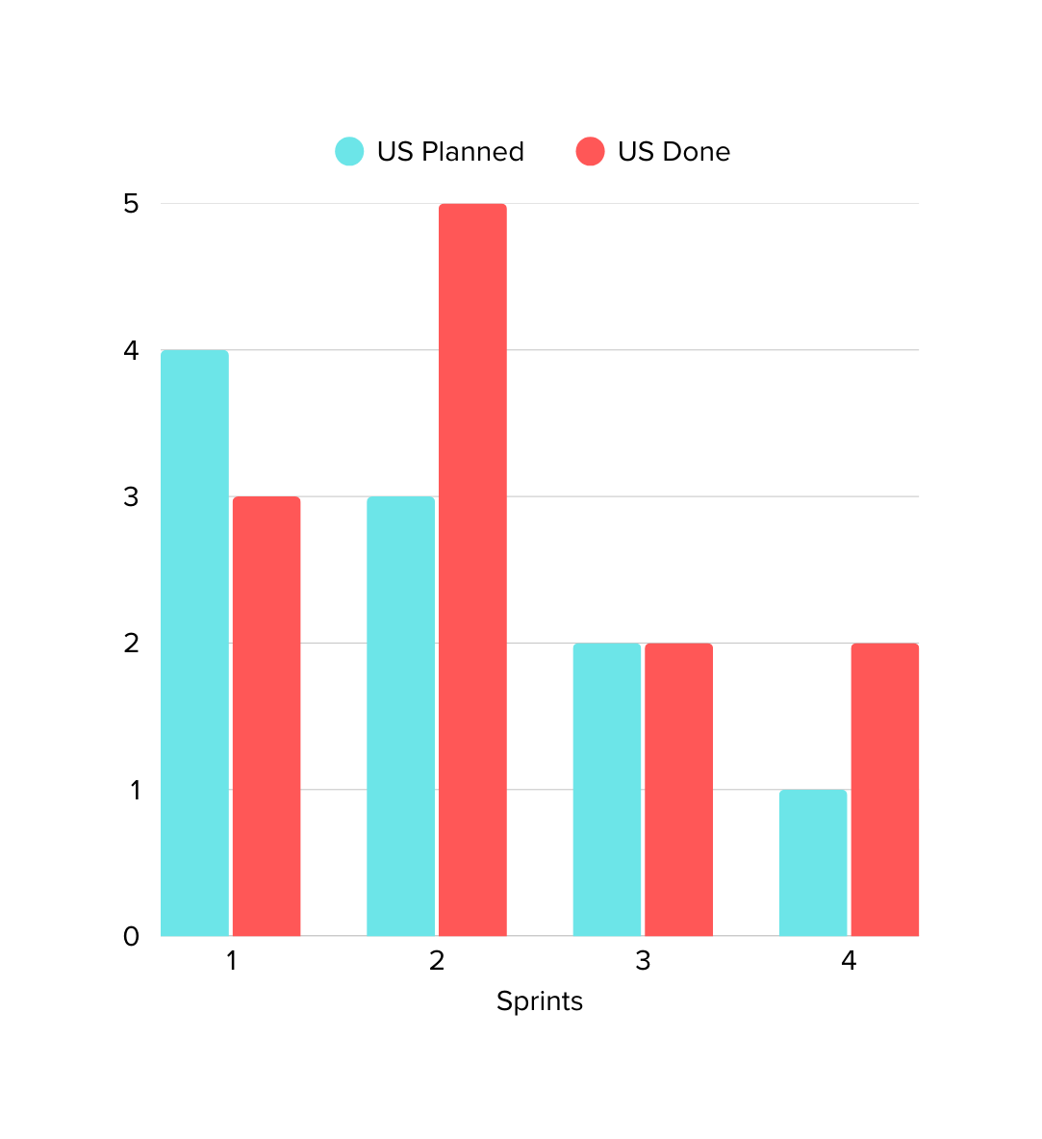
Presented by → José Moreira
SPRINT
GOALS
SPRINT GOAL SUCCESS RATE MEASURED BY USER STORIES
After the initial sprint we managed to always achieve or surpass the sprint goal

Slide 21
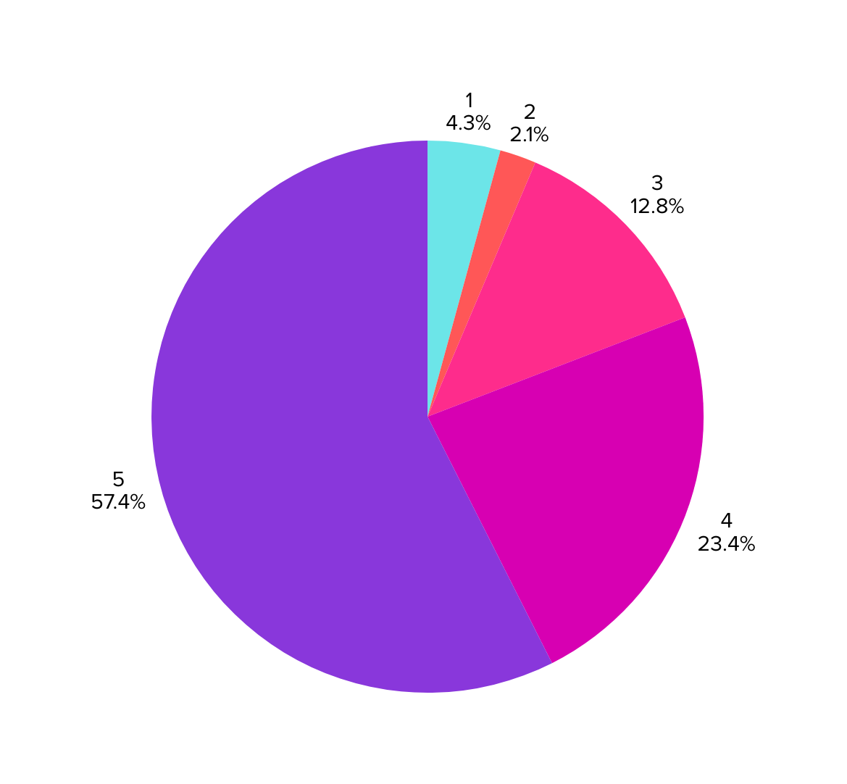
Presented by → José Moreira
CUSTOMER LOYALTY
We measured the customer loyalty using a net promoter score with answers received in surveys to potential users.
47
TOTAL ANSWERS

Slide 22
7. LESSONS LEARNED

Slide 23


Presented by → Tiago Oliveira
LESSONS LEARNED
What lessons do you leave for future projects?
José Moreira: We realized that adapting to different working styles and bridging communication gaps were our biggest hurdles. However, we discovered that establishing a well-defined workflow was the key to overcoming these friction points, providing the structure needed to align the team and streamline collaboration.
Pedro Amorim: This project taught me that 'flexibility' requires a solid foundation. Our team initially struggled with the rapid pace of change and varying communication habits, but we found our stride by consolidating our Scrum framework. Establishing this consistent workflow was the key to eliminate team friction.

Slide 24
Presented by → Tiago Oliveira
LESSONS LEARNED
What lessons do you leave for future projects?
Beatriz Marques: I learned that effective planning goes beyond just listing features; it requires realistic estimation and risk management. We initially struggled with overarching some user stories and blocking external dependencies like API limits. However, we found that decomposing complex features into granular tasks and implementing fallback strategies were the keys to balancing the workload and ensuring continuous delivery without bottlenecks.
Tiago Oliveira: The start of the project was characterized by a steep learning curve. We faced initial difficulties with team organization and a lack of experience with essential tools like GitLab. However, through a collective effort and the establishment of a rigorous workflow, we successfully overcame these barriers. This challenge evolved into an opportunity for growth, allowing us to master new tools and strengthen our collaboration.

Slide 25
THANK YOU !!

